Slide 1

A CAPSTONE PROJECT
TELECOMMUNICATION CUSTOMER CHURN PREDICTION

Slide 2
INTRODUCTION
The identification of consumers who run the danger of terminating their relationship with a telecommunications provider requires the application of data analysis and predictive modelling tools. Churn is a crucial indicator for telco firms since it has a direct impact on their customer base and income. Churn is the rate at which consumers transfer to a different service provider.
Gathering and preprocessing customer data, such as demographics, use patterns, billing information, customer service interactions, network performance indicators, and contractual data, is the first step in the churn prediction process. Following analysis, prediction models are created using these factors.
In telecom communication, churn prediction offers a number of advantages. Telco businesses can proactively take action to retain customers by properly identifying those who are more likely to churn. This includes conducting tailored marketing efforts, providing individualized offers and promotions, enhancing the network, and enhancing customer care and support. These customer retention tactics seek to raise satisfaction levels, foster loyalty, and lower turnover rates.

Slide 3
ABOUT DATA
There are 7043 rows and 20 columns the dependent variable churn has two values "NO" and "YES“.
The answer "No" means that the client did not churn. It signifies that the customer is regarded as being kept by the telco business for the particular observation period based on the data and analyses that are now available.
"Yes" indicates that the client churned. It indicates that the client stopped using services and changed to a new telecom provider during the observation period based on the data and analyses that were available.

Slide 4
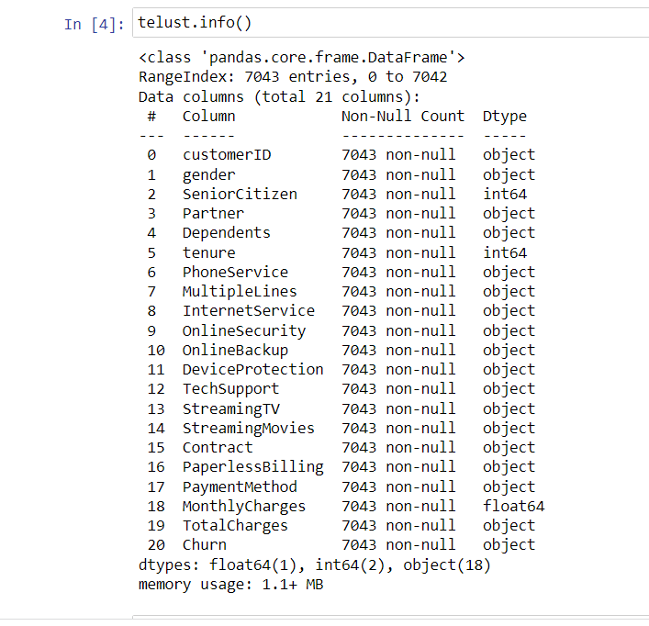

Slide 5
PROBLEM STATEMENT
The challenge is to create reliable and precise churn prediction models that use cutting-edge data analysis methods, such as machine learning and predictive modelling, to pinpoint consumers in the telecommunications sector who are at risk of leaving.
These models ought to take a variety of factors into account, capture intricate interactions, and allow telecommunications firms to create targeted retention plans, raise client satisfaction levels, and lower churn rates.

Slide 6
METHODOLOGY
We'll start by reading the data, and then we'll do some data analysis.
Data analysis is the process of utilizing analytical or statistical techniques to examine data in order to find important information.
We will identify the data distribution and data categories after data analysis.
5 classification algorithms will be trained in order to forecast the results. Additionally, we'll evaluate the results. Start the project implementation process now.
Logistic Regression
Decision Tree Classifier
Random Forest Classifier
Gradient Boosting Classifier
KNeighbors Classifier

Slide 7
PROCEDURE
Load and Clean Data
EDA
Hypothesis Testing
Model Evaluation
Classification Models
Feature Engineering

Slide 8
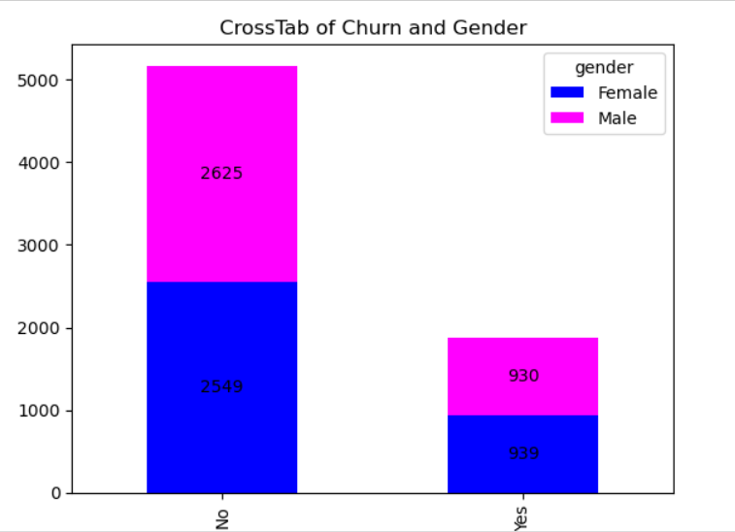
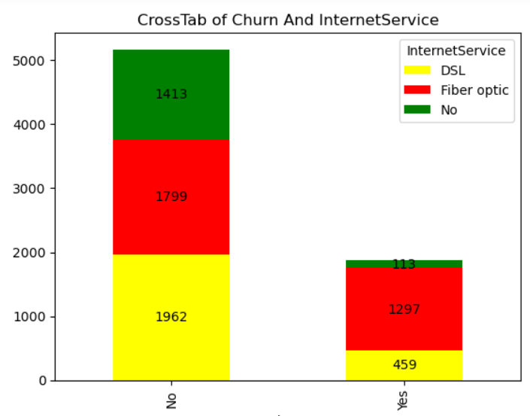
VISUALIZING TARGET VARIABLE

Slide 9
HYPOTHESIS TESTING
A statistical technique known as hypothesis testing is used to deduce information from sample data and come to conclusions about the population.
The two conflicting hypotheses are the null hypothesis (H0) and the alternative hypothesis (H1 or Ha).
The null hypothesis denotes the presumption that there is no meaningful difference or relationship between variables, or that any difference that is seen is the result of chance. On the other hand, the alternative hypothesis suggests that there is a significant difference or relationship within the population.

Slide 10
LOGISTIC REGRESSION
A statistical method called logistic regression is used to forecast binary outcomes or categories. Similar to making a "yes" or "no" forecast. On the basis of the input factors, it determines the likelihood that an event will occur. In several industries, including healthcare, banking, and marketing, logistic regression is frequently used to forecast outcomes like disease diagnosis, loan defaults, or customer attrition. It offers a straightforward and understandable method for calculating probabilities and making binary predictions.
DECISION TREE CLASSIFIER
A decision tree classifier is a machine learning method that generates predictions or choices by adhering to an if-then framework. It imitates how people make judgements by posing a series of queries and drawing inferences from the responses. A new query is posed based on several features at each internal node of the tree. Up until it reaches the leaf nodes, which contain the anticipated result (pass or fail) based on the data acquired from the prior questions, the algorithm keeps separating the data into smaller subgroups.The training data is used by the decision tree classifier to learn which questions to ask and how to divide the data at each node.

Slide 11
RANDOM FOREST CLASSIFIER
A machine learning system called a random forest classifier mixes different decision trees to generate predictions. It's an ensemble learning technique that makes use of the strength of various models to raise generalization and accuracy.
Using a random portion of the data and a random subset of features, the Random Forest Classifier builds a collection of decision trees. Each tree independently generates predictions, and the combined results from all the trees are used to determine the final prediction.
GRADIENT BOOSTING CLASSIFIER
Several weak prediction models (usually decision trees) are combined by a gradient boosting classifier, a machine learning technique, to produce a powerful predictive model.
It is an ensemble learning technique that develops models sequentially and iteratively, fixing the flaws of the prior models with each new model.

Slide 12
KNEIGHBOURS CLASSIFIER
A straightforward machine learning technique used for classification tasks is the k-Nearest Neighbours (k-NN) classifier.
It operates by locating the k nearest neighbours in the feature space to a new data point, and then assigning a class label based on the consensus of those neighbours.

Slide 13
PERFORMANCE METRICS OF ALGORITHM
ALGORITHM | RECALL VALUE |  | ACCURACY
 | 0 | 1
Logistic Regression | 0.85 | 0.66 | 0.80
Decision Tree Classifier | 0.86 | 0.72 | 0.83
Random Forest | 0.95 | 0.91 | 0.94
Gradient Boosting Classifier | 0.85 | 0.72 | 0.83
Kneighbors Classifier | 0.87 | 0.73 | 0.84

Slide 14
CONCLUSION
Out of all the Algorithms Random Forest Classifier has performed good.
Entered the predicted test values into the competition Learning:
Predict “CHURN” all of the models the most accurate classification method is Random Forest Classifier with Accuracy 0.94

Slide 15

THANK YOU
Mohammad Nayeem
nayeemmsd7@gmail.com
PGA 26

